Slide 1

DEPARTMENT OF COMPUTER SCIENCE AND ENGINEERING
INTERNATIONAL ISLAMIC UNIVERSITY CHITTAGONG
Supervisor
Team Name
Ashifatul Ferdousi
Assistant Lecturer
Dept. of CSE, IIUC.
THE
HASHTAG

Slide 2


Team Details:
.
Afia Ibnat.
ID- C231516.
.
Sabiha Ahmed Tasnim Tinni.
ID- C231542.

Slide 3

_Name of the project_
“CLASSROOM MANAGEMENT SYSTEM”

Slide 4
Presentation’s Overview
Introduction.
Objectives.
Research Background(Previous Research).
Methodology(Tools,Language,Algorithm).
Code Snippet & Output.
Result & Discussion.
Limitations.
Future Work.
Conclusion.

Slide 5
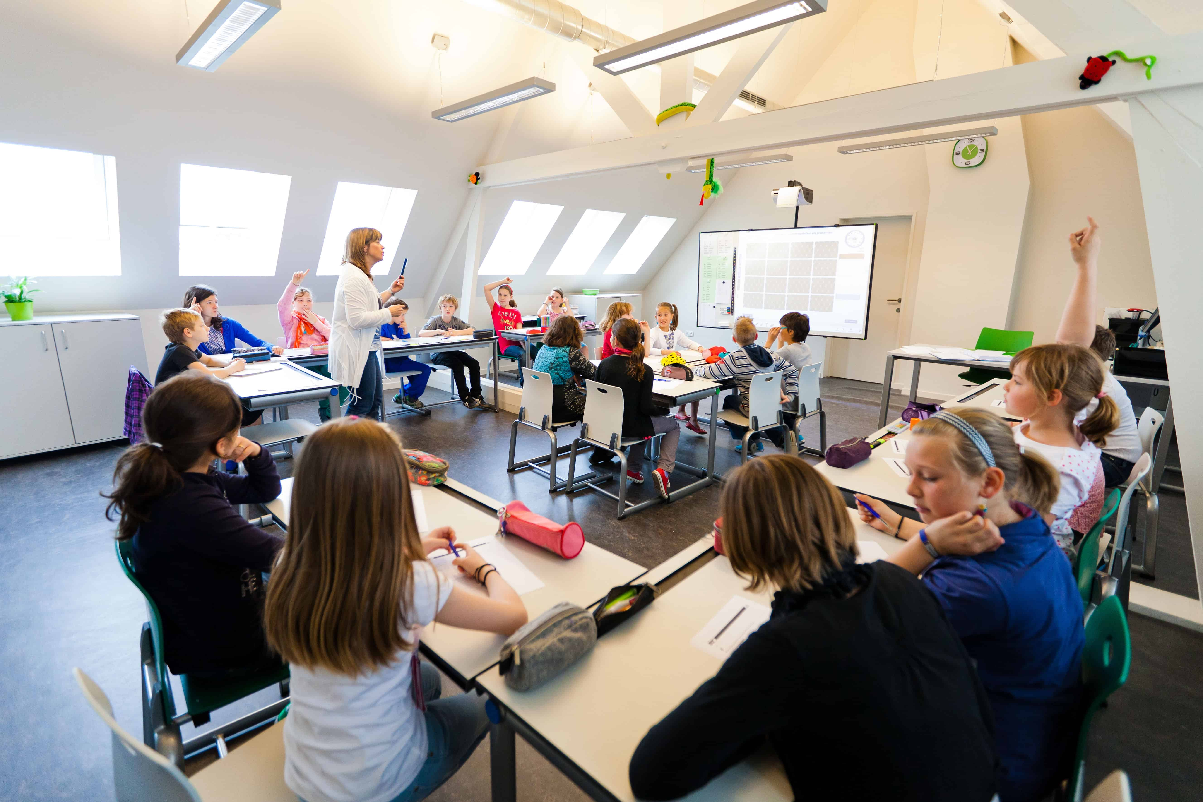
Introduction
This project handles the management of a classroom . It allows users to add, display, and delete student information, manage class schedules, and conduct a quiz for assessment. The system provides a menu-driven interface for easy navigation and interaction.

Slide 6

Objectives
To make a suitable and secure system for classroom’s management.
To upgrade from a paper-based system to computerized system.
To lessen the risk of losing records.

Slide 7
Research Background
Linked Lists and Their Applications:
https://www.programiz.com/dsa/linked-list
https://www.geeksforgeeks.org/introduction-to-linked-list-data-structure-and-algorithm-tutorial/
For Project:
https://www.researchgate.net/publication/284171115_Classroom_Management_in_Project_Work
https://www.researchgate.net/publication/351819204_Classroom_management
https://youtu.be/u8kUwpO3ucw

Slide 8

Methodology
ALGORITHM :
Step 1: Start the program.
Step 2: Declare constants MAX_STUDENTS and MAX_SCHEDULES.
Step 3: Define Schedule and Student structures.
Step 4: Define node structure for linked list implementation.
Step 5: Function prototypes.
Step 6: Implement main function.
Step 7: Display welcome message and menu.
Step 8: Repeat until user chooses to exit.
Step 9: Prompt user for choice.
Step 10: Perform corresponding operation based on choice.
Step 11: End the program.
PLATFORM :
Codeblocks
LANGUAGE :
Here we use C++ programming language.

Slide 9
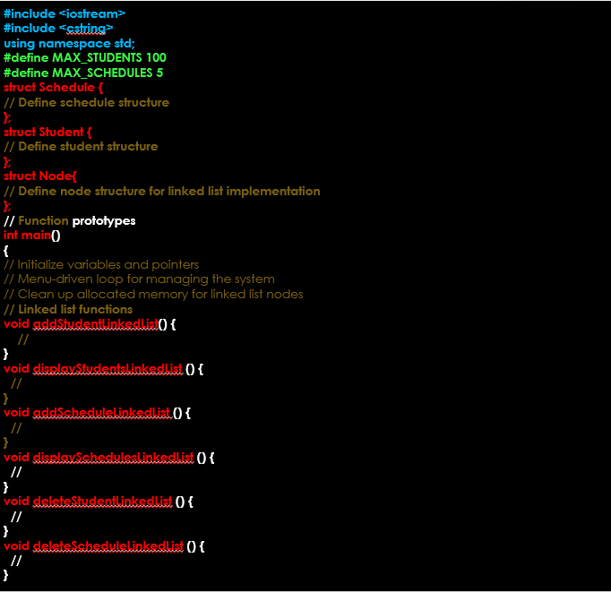
Code Snippet

Slide 10
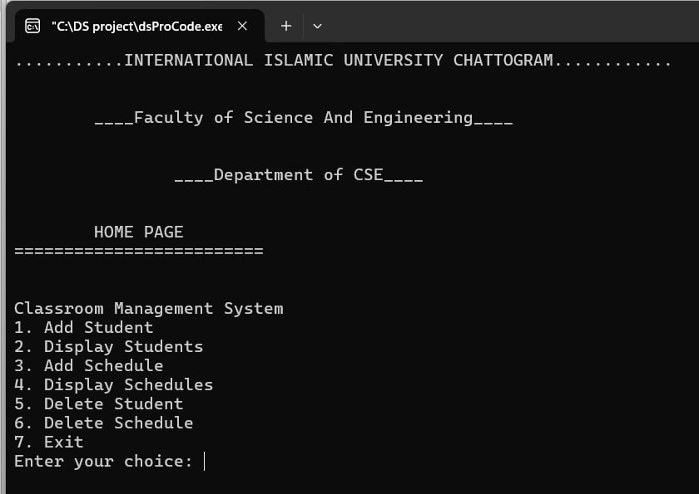
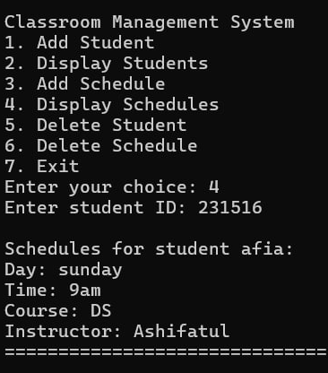
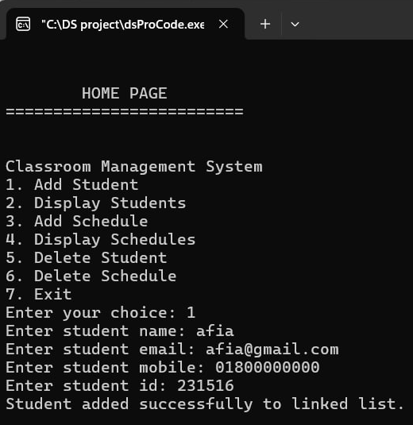
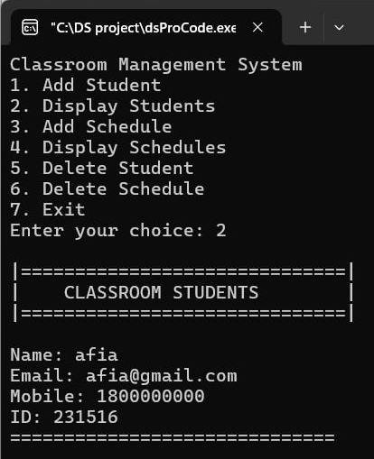
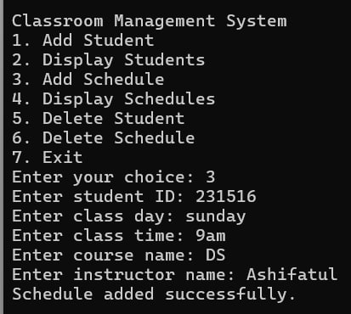
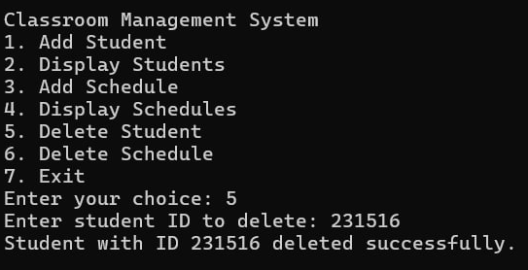
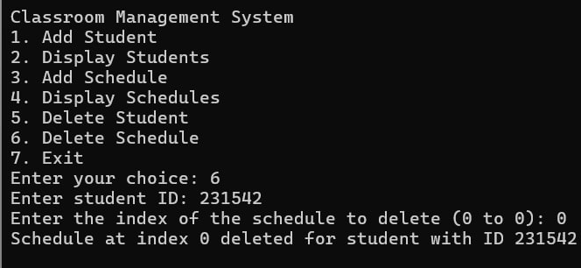
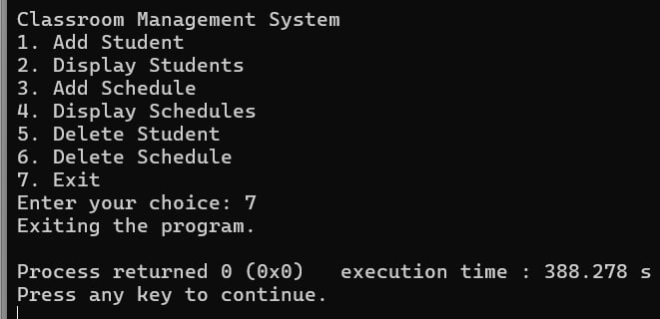
Output

Slide 11

RESULT & DISCUSSION
Result:
The system provides an interactive way to manage student records and their schedules through a console interface, allowing for adding, displaying, and deleting both student information and their associated schedules.
Discussion:
This program provides a basic classroom management system with functionalities to add and manage students and their schedules using a linked list. Each student can have up to a defined maximum number of schedules. The program allows for dynamic addition, display, and deletion of both students and their schedules.

Slide 12
LIMITATIONS
Scalability: May struggle with large student populations, limiting suitability for bigger institutions.
Limited Customization: May not adapt well to unique educational needs, reducing usefulness for institutions with specific workflows or preferences.

Slide 13
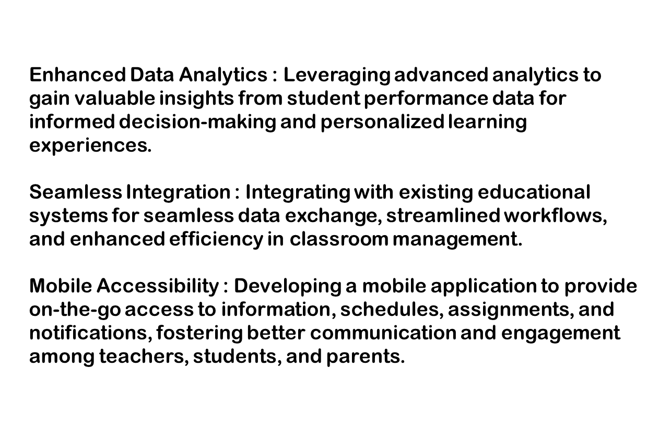
FUTURE WORK

Slide 14
CONCLUSION
This project simplifies classroom management with a computerized system, enabling easy access to information and efficient student handling. However, it has scalability and customization limitations. Overall, it lays the groundwork for improving classroom operations.

Slide 15
THANK YOU

